Slide 1
University Ride Sharing App
Final Year Project
Group # 14
Ali Yaqoob (EB21102014)
Anas Rizwan (EB21102052)
Muhammad Asad Qaisar (EB21102056)
Oubaid Ahmed Siddiqui (EB21102088)

Slide 2
Introduction
This project aims to create a ride-sharing application specifically for university students. The app will allow students driving their own vehicles to offer rides to other students travelling to the same destination, such as from the university to home or vice versa. The application will focus on providing a secure and efficient platform for students commuting along similar routes.

Slide 3
Problem Statement
Many university students commute daily between their homes and the university. Often, students drive alone, while others lack convenient transportation options. A platform designed specifically for university students, focusing on shared rides for common routes, would promote convenience, reduce travel costs, and encourage a sustainable environment.

Slide 4
Objectives
To develop a mobile application that allows students from the same university to connect with fellow students driving along the same route. The application will enable student drivers to offer rides, specify the number of available seats, and set a price, while student users can search for rides, confirm bookings, and share costs. Gender specification will be included during registration to accommodate preferences and ensure comfort for all users. If no ride is found, the student user will have the option to book a rickshaw.

Slide 5
Project Scope
User Registration and Authentication:
Secure registration using university email verification.
Ensure all users are affiliated with the university.
Gender Preference Handling:
Include gender specification during registration.
Accommodate preferences to ensure comfort in ride-sharing.
Ride Creation and Search:
Allow drivers to create ride listings with journey details and seat availability.
Enable users to search for rides based on their needs and preferences.
Booking and Payment:
Facilitate ride confirmations through the app.
Payment Option:
Allow drivers to optionally charge for rides or offer them for free.
Manage seat availability and costs dynamically based on driver preferences.
University-Centric Design:
Create a user interface and experience tailored to the university environment.
Enhance relevance and usability.

Slide 6
Benefits & Impact
Benefits
Impact
Convenience and Accessibility: Students can easily find rides or offer them, saving time on commuting arrangements and making transportation more accessible.
Cost Savings: By sharing rides, students can reduce their transportation costs, making the app a cost-effective solution for daily commutes and occasional trips.
Community Building: The app fosters a stronger sense of community among university students, allowing them to connect and build relationships through shared rides.
Enhanced Safety: University email verification and gender preference settings ensure a safe and comfortable ride experience, building trust among users.
Reduced Campus Traffic and Parking Demand: By encouraging students to share rides, the app helps reduce campus traffic and alleviates parking congestion, contributing to a more organized campus environment.
Positive Environmental Footprint: Fewer single-occupancy vehicles mean less pollution, directly supporting university sustainability goals and promoting a culture of eco-friendly practices.
Improved Student Well-being: By reducing commuting stress and providing more reliable transportation, students experience better convenience, ultimately supporting their well-being and academic success.
Promotes Inclusivity and Comfort: Gender specification options allow students to feel more comfortable with their ride-sharing choices, encouraging inclusivity within the app.
Supports University Safety Initiatives: By limiting users to verified university students and providing alternative ride options (e.g., rickshaws), the app aligns with university safety goals and offers a reliable fallback transportation method.

Slide 7
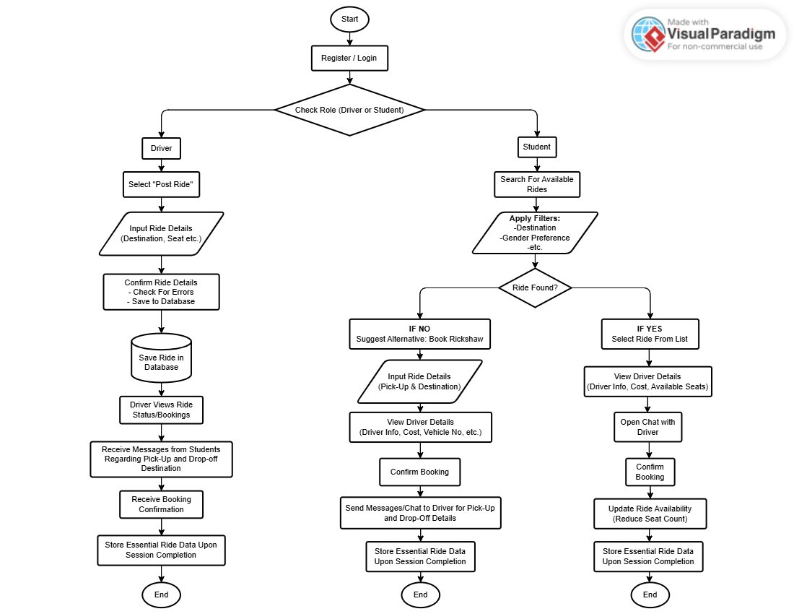
Flow Chart

Slide 8
Technology Stack & Methodology
Technology Stack
Methodology
Frontend:
React Native (cross-platform mobile application development).
Backend:
Node.js or Dot Net Core (for server-side development).
Database:
Microsoft SQL Server (for data storage).
Frontend Development:
Implement the user interface using React Native.
Ensure cross-platform compatibility for both iOS and Android devices.
Backend Development:
Set up the server using Node.js or .NET Core.
Develop RESTful APIs for user registration, ride listings, booking, and payments.

Slide 9
Key Features & Expected Outcomes
Key Features
Expected Outcomes
User Registration and Authentication.
Gender Preference Handling.
Ride Creation and Search.
Booking and Payment Options.
University-Centric Design.
Improved connectivity among students.
Cost-effective transportation options.
Enhanced safety and comfort in ride-sharing.

Slide 10
Conclusion
The University Ride Sharing App offers a practical solution for students seeking safe and convenient transportation. By promoting shared rides and accommodating gender preferences, the app enhances comfort and security for all users.
This initiative not only reduces travel costs but also supports environmental sustainability by decreasing the number of vehicles on the road. Overall, the app aims to foster a collaborative and efficient commuting experience for the university community.

